Slide 1

Python Operators
Smruti Ranjan

Slide 2
Type of Operators
Arithmetic operators
Assignment operators
Comparison operators
Logical operators
Bitwise operators
Identity operators
Membership operators

Slide 3
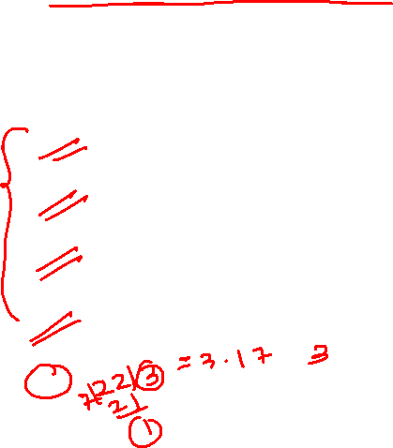

Arithmetic operators
Operator | Meaning | Example
+ | Addition | >>>2+3 >>>5
- | Subtraction | >>>6–8 >>>-2
* | Multiplication | >>>5*6 >>>30
/ | Division | >>>25/5 >>>5
// | Floor division - division that results into whole number | >>>22//7 >>>3
% | Modulus - remainder of the division of left operand by the right | >>>3%2 >>>1
** | Exponent - left operand raised to the power of right | >>>2**3 >>>8

Slide 4

Assignment operators
Lets say x = 5
Operator | Meaning | Example
+= | Right side value will first add to variable (x), then assign to variable (x) | >>>x += 1 >>>print(x) >>>6
*= | Right side value will first multiply to variable (x), then assign to variable (x) | >>>x *= 2 >>>print(x) >>>6

Slide 5

Comparison operators
Lets say x = 5 and y = 8
Operator | Meaning | Example
> | Greater than - True if left operand is greater than the right | >>>x > y >>>False
< | Less than - True if left operand is less than the right | >>>x < y >>>True
== | Equal to | >>>x == y >>>False
!= | Not equal to | >>>x != y >>>True
>= | Greater than or equal to - True if left operand is greater than or equal to the right | >>>x >= y >>>False
<= | Less than or equal to - True if left operand is less than or equal to the right | >>>x <= y >>>True

Slide 6

Logical operators
Lets say x = True , y = False
Operator | Meaning | Example
and | True if both the operands are true | >>>x and y
or | True if either of the operands is true | >>>x or y
not | True if operand is false (complements the operand) | >>>not x

Slide 7
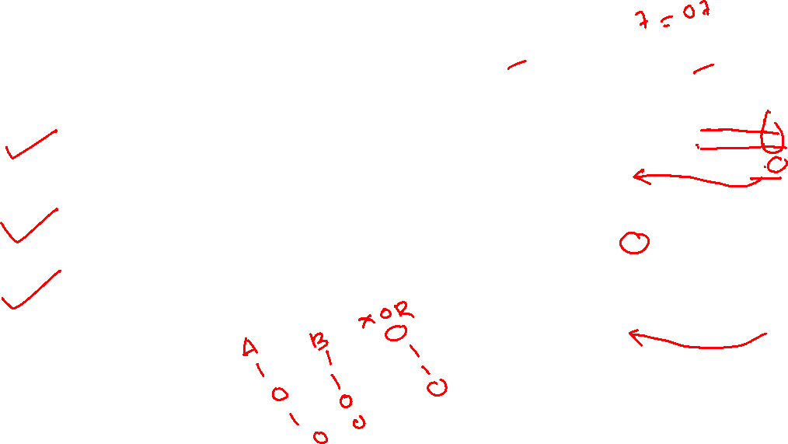
Bitwise operators
Lets say x = 7 (0000 0111) , y = 5 (0000 0101)
Operator | Meaning | Example
& | Bitwise AND | >>>x & y #0000 0111 #0000 0101 >>>5 #0000 0101
| | Bitwise OR | >>>x | y #0000 0111 #0000 0101 >>> 7 #0000 0111
^ | Bitwise XOR | >>>x ^ y #0000 0111 #0000 0101 >>>2 #0000 0010

Slide 8
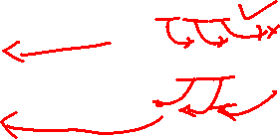
Bitwise operators
Lets say x = 7 (0000 0111) , y = 5 (0000 0101)
Operator | Meaning | Example
>> | Bitwise right shift | >>>x>> 2 #0000 0111 >>>1 #0000 0001
<< | Bitwise left shift | >>>x<< 2 #0000 0111 >>>28 #0001 1100

Slide 9
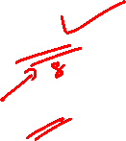
Identity operators
Lets say x = 8
Operator | Meaning | Example
is | True if the operands are identical (refer to the same object) | >>>x is 8 >>>True
is not | True if the operands are not identical (do not refer to the same object) | >>>x is not 8 >>>False

Slide 10

Membership operators
Lets say x = (1,5,8)
Operator | Meaning | Example
in | True if value/variable is found in the sequence | >>>5 in x >>>True
not in | True if value/variable is not found in the sequence | >>>5 not in x >>>False

Slide 11
Thanks for watching.
Please do like & share this video, and don’t forget to subscribe this channel.
See you next time.
Until then
Cheers!

